Slide 1
Smart Event: Personalized Event Planning with ChatGPT
Yoshitha Yerra (856556669)
Nalini reddy Kota (856536236)
Nimisha Kaleri (856558739)

Slide 2
Current problem statement
Traditional event planning lacks efficiency and customization, resulting in subpar experiences. The necessity for a comprehensive, technology-driven solution is obvious.
'Smart Event' seeks to revolutionize event planning by integrating ChatGPT, providing users with a smooth and customized method to seamlessly build memorable and unique events.

Slide 3
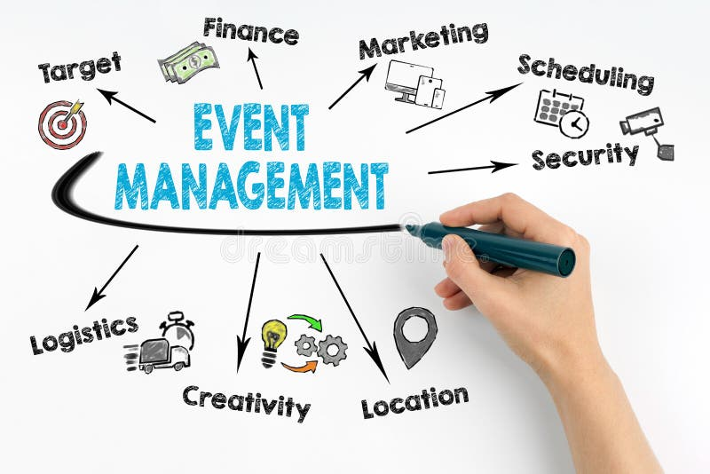
INTRODUCTION
To construct a user-friendly and intelligent event planning chatbot, where chatbot will converse with users in natural language to gather event details, preferences, and requirements before providing customized event recommendations and planning support. It is useful for people who want to schedule a variety of events while leveraging data-driven advice.
.

Slide 4
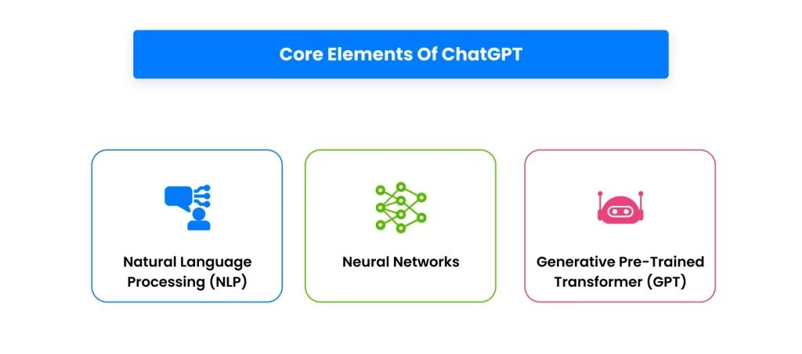
ROLE OF CHATGPT
A number of variables are taken into account when choosing a venue for a customized event, such as the host's preferences, the type of event, and logistical issues.
Synergy between ChatGPT and data mining empowers event planning systems to offer a personalized, adaptive, and efficient experience.
The combination of natural language understanding and data-driven insights ensures that users receive recommendations that resonate with their unique preferences, ultimately leading to more enjoyable and memorable events.

Slide 5
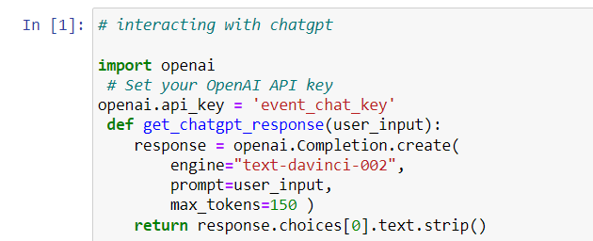
Interaction with ChatGPT
We use a Python library, OpenAI to interact with the ChatGPT API.
By getting user input, send it to ChatGPT for generating responses.

Slide 6
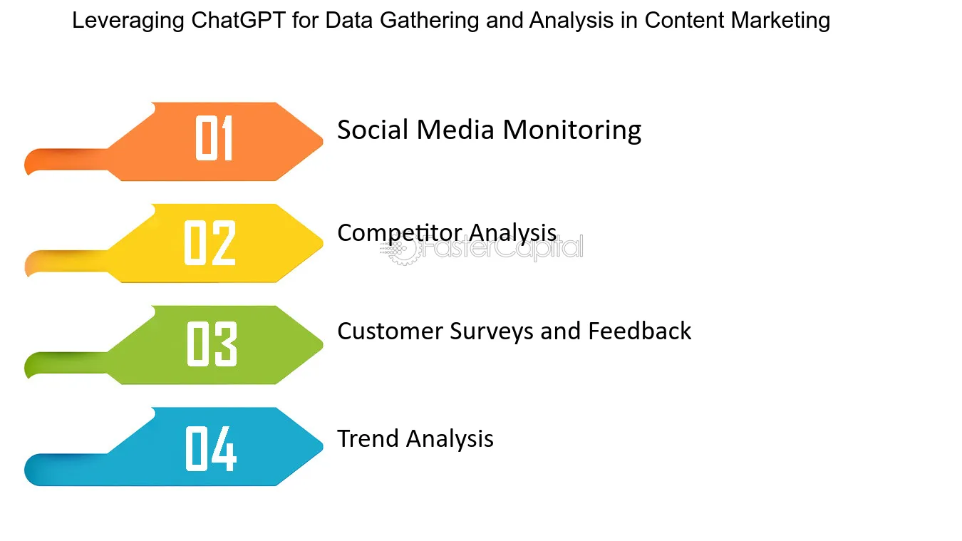
Data collection
User can enter their preferences, Chatbot collects all the information and display all the possible options on the screen.
The data collection process focus on gathering information relevant to user preferences, past events, feedback, and contextual data.

Slide 7

Data set retrieval
A Kaggle dataset, also known as a Kaggle Kernel is a set of data provided by companies, students, and alum.
Kaggle Datasets are public data collections used for training, research, prediction, and fun. These datasets can be manipulated by students, enthusiasts, and companies for business purposes.

Slide 8
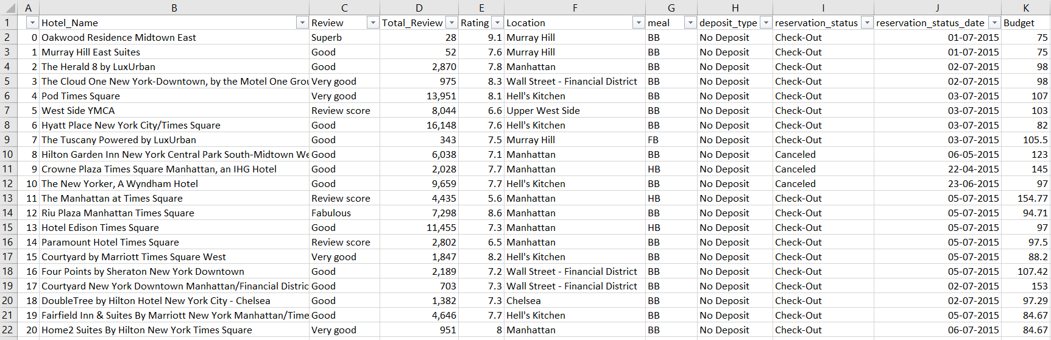
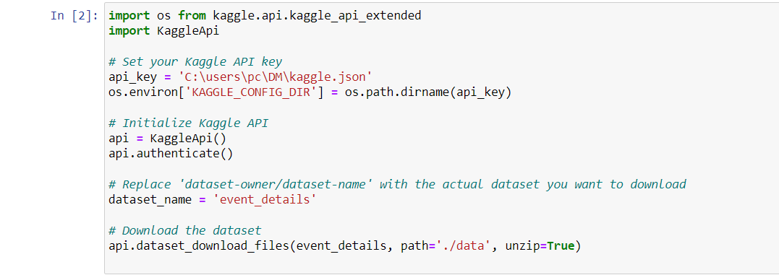
Data preprocessing

Slide 9
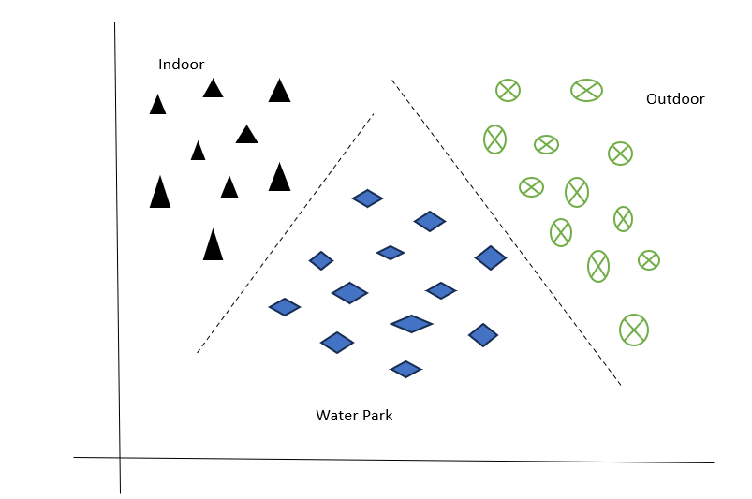
Data classification
A crucial element that enables the system to understand and classify different facets of event planning, user preferences, and requests in ChatGPT for Event Planning and Recommendations is classification.
Event planning becomes more effective and customized to the user's needs thanks to this classification, which also enables the chatbot to offer personalized and context-aware advice and assistance.

Slide 10
Naive bayes classifier
Naive Bayes classifiers are effective in many real-world applications, especially in text classification and spam filtering.
The fundamental idea behind a Naive Bayes classifier is to calculate the probability of a given instance belonging to a particular class based on the observed features.
Efficiency of Naive Bayes make it a popular choice, especially when dealing with high-dimensional datasets.

Slide 11
Implementation of Naive Bayes
Data Preparation
Data Exploration
Calculate Probabilities
Make Predictions
Handle Real-World Data
Implementation

Slide 12
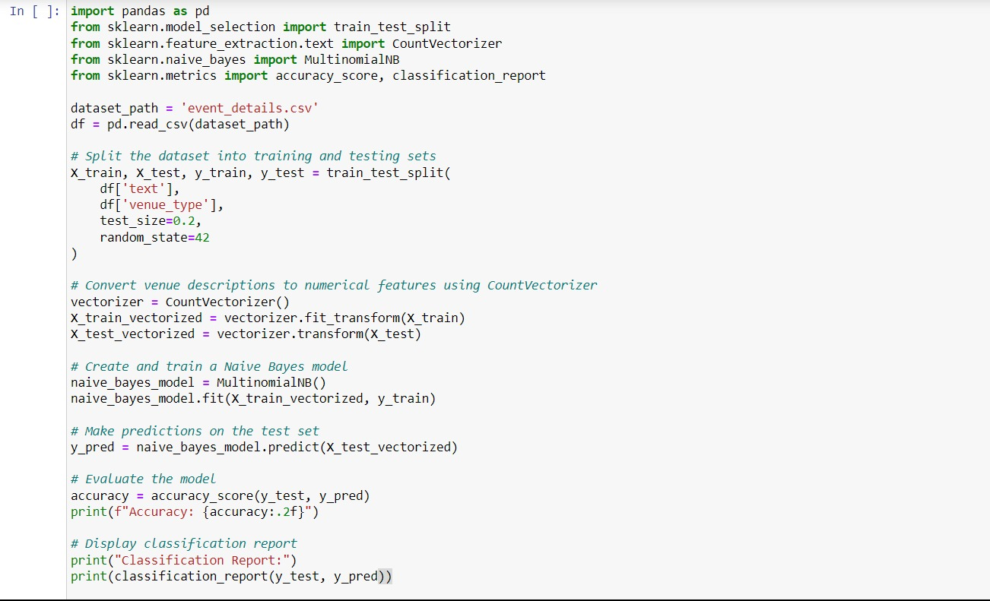

Slide 13
Sample Data set
Client Name | Event Type | Event Date | Status | Theme | Tasks
David | Office Party | 28th Oct 2023 | In Process | NO | Seating arrangement
Karan | Birthday party | 1st Nov 2023 | All Finalized | NO | Seating arrangement, Dinner, Drinks, Gifts
Elizabeth | Bachelors party | 6th Oct 2023 | Working on it | YES | Decoration, Food, Activities and Games
Stephney | Birthday party | 1st Nov 2023 | Cancelled | NO
Ross | Family gathering | 10th Nov 2023 | In Process | NO | Refreshments, Lunch, Organize fun activities
Maxwell | Wedding | 30th Sep 2023 | All Finalized | NO | Decorations, banquet, gifts, Food, Drinks, seating arrangement
Rachel | Birthday party | 21st Oct 2023 | Pending | YES | Games, finalizing food

Slide 14
Sample Data set
Venue name | Location | Capacity of people | Cost ($) | Venue Type | Availability on required date
abc | ABC | 100-150 | 17000-18500 | Outdoor | Yes
xyz | XYZ | 500-650 | 65000-68000 | Waterpark | Yes
mno | MNO | 300-400 | 50000-53000 | Indoor | No
stu | STU | 70-100 | 12000-15000 | Indoor | Yes
ghf | GHF | 100-200 | 23000-25000 | Outdoor | No

Slide 15
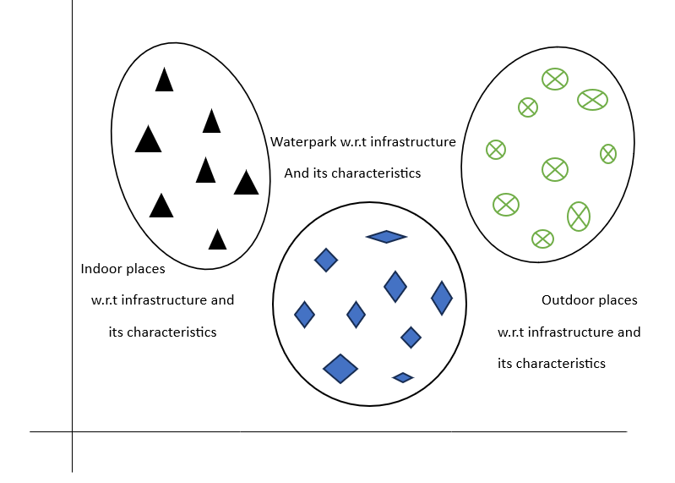
clustering
Clustering can be a valuable technique for grouping similar users or events together.
It can improve the granularity of personalized recommendations and contribute to a more tailored and effective event planning experience for users, such that user will be able to select a perfect venue from all the available options.

Slide 16
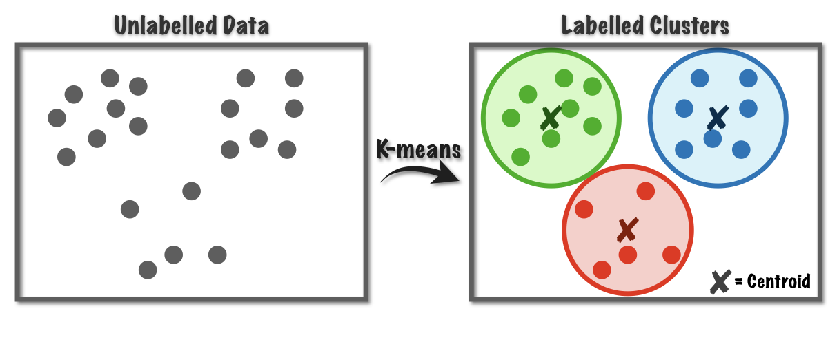
K-means clustering
The K-Means clustering algorithm, a widely adopted unsupervised machine learning technique, is employed to divide a dataset into K unique and non-overlapping subsets, known as clusters. Each data point is assigned to the cluster with the closest mean, acting as a representative prototype for that cluster. The primary objective of the algorithm is to minimize the sum of squared distances between data points and their corresponding cluster centroids.

Slide 17
K-means clustering
Initialization: Randomly select K data points to serve as initial cluster centroids.
Assignment: Assign each data point to the cluster with the closest centroid.
Update Centroids: Recalculate cluster centroids by computing the mean of the data points in each cluster.
Repeat Steps 2-3: Iterate through the assignment and centroid update steps until convergence is reached (when centroids exhibit minimal change or after a predefined number of iterations).
K-Means is versatile across various data types, but proper preprocessing is crucial, particularly when dealing with features of disparate scales. Common preprocessing steps include normalizing or standardizing features.

Slide 18
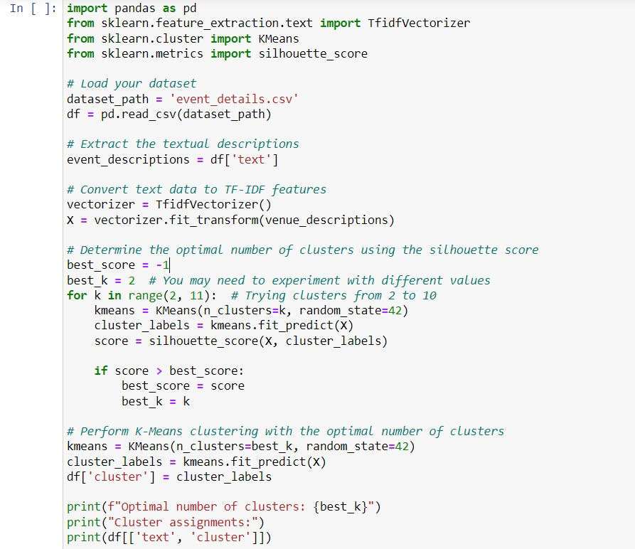

Slide 19
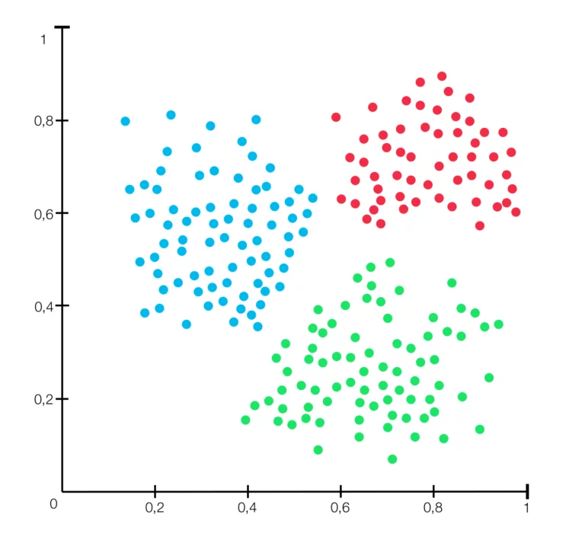
Sample clusters
X-axis implies the budget of the venue
Y-axis implies the occupancy of the event
Outdoor
Indoor
Waterparks

Slide 20
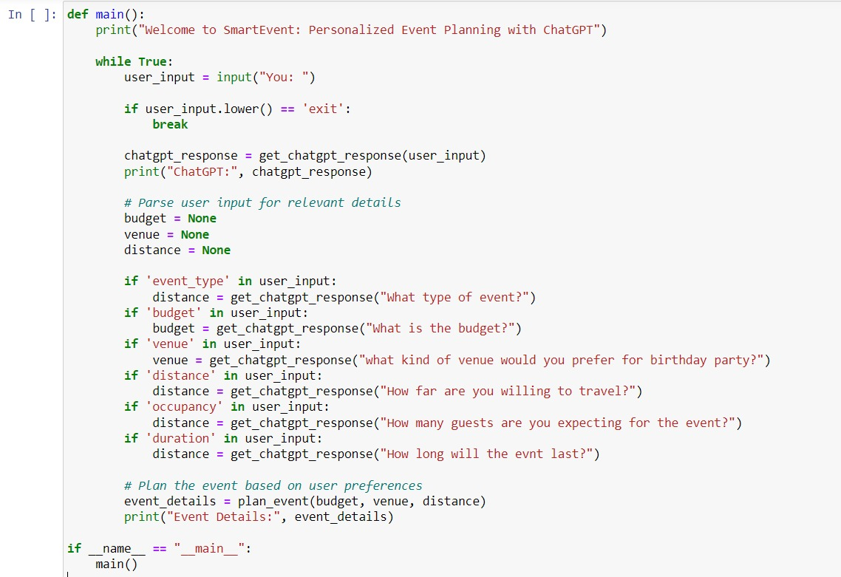
implementation

Slide 21

Sample Output
When User selects budget, ChatGPT retrieves the data of budget from dataset, according to customer budget request then ChatGPT returns the related event detail values.

Slide 22
Future scope
The future scope of "Smart Event: Personalized Event Planning with ChatGPT" could involve several exciting possibilities and enhancements.
Explore more advanced integration with ChatGPT or similar language models. Leverage advancements in natural language processing to provide more sophisticated conversational interactions during event planning. Improve personalization by incorporating user preferences, historical data, and feedback. Create a system that learns from past interactions to offer more tailored event suggestions.
Extend the platform to support global event planning, considering cultural differences, regional preferences, and diverse event requirements. Provide multi-language support for a more inclusive experience. Prioritize and enhance security and privacy features, especially when dealing with sensitive information related to events. Implement robust data protection measures and compliance with relevant privacy regulations.

Slide 23
conclusion
The integration of ChatGPT in our personalized event planning system has successfully empowered users to effortlessly orchestrate a diverse range of events.
The seamless interaction with the chatbot not only streamlined the planning process but also enhanced user satisfaction, making event planning an intuitive and enjoyable experience.
This project marks a significant advancement in the realm of personalized services, showcasing the potential of natural language processing and data mining to redefine how users plan and enjoy their events.

